Slide 1
Supports and Services to Turbocharge the Recovery Journey
Steven Samra
Associate, C4 Innovations
April 28, 2021

Slide 2
Working with Communities
The SAMHSA-funded Opioid Response Network (ORN) assists states, organizations and individuals by providing the resources and technical assistance they need locally to address the opioid crisis and stimulant use.
Technical assistance is available to support the evidence-based prevention, treatment and recovery of opioid use disorders and stimulant use disorders.
Funding for this initiative was made possible (in part) by grant no. 1H79TI083343 from SAMHSA. The views expressed in written conference materials or publications and by speakers and moderators do not necessarily reflect the official policies of the Department of Health and Human Services; nor does mention of trade names, commercial practices, or organizations imply endorsement by the U.S. Government.

Slide 3
Contact the Opioid Response Network
The Opioid Response Network (ORN) provides local, experienced consultants in prevention, treatment and recovery to communities and organizations to help address this opioid crisis and stimulant use.
ORN accepts requests for education and training.
Each state/territory has a designated team, led by a regional Technology Transfer Specialist (TTS), who is an expert in implementing evidence-based practices.
For more information
    Visit www.OpioidResponseNetwork.org
    Email orn@aaap.org
    Call 401-270-5900

Slide 4

Today’s Learning Objectives
Identify at least two best practices in engaging with and supporting individuals experiencing behavioral health challenges
Discuss the importance of a trauma-informed, person-centered approach when engaging and serving people with behavioral health concerns
Describe at least two wraparound services and why they are important in supporting an individual's recovery journey
Explain the impact of stigma upon individuals with behavioral health challenges and implications for treatment access and overall success

Slide 5
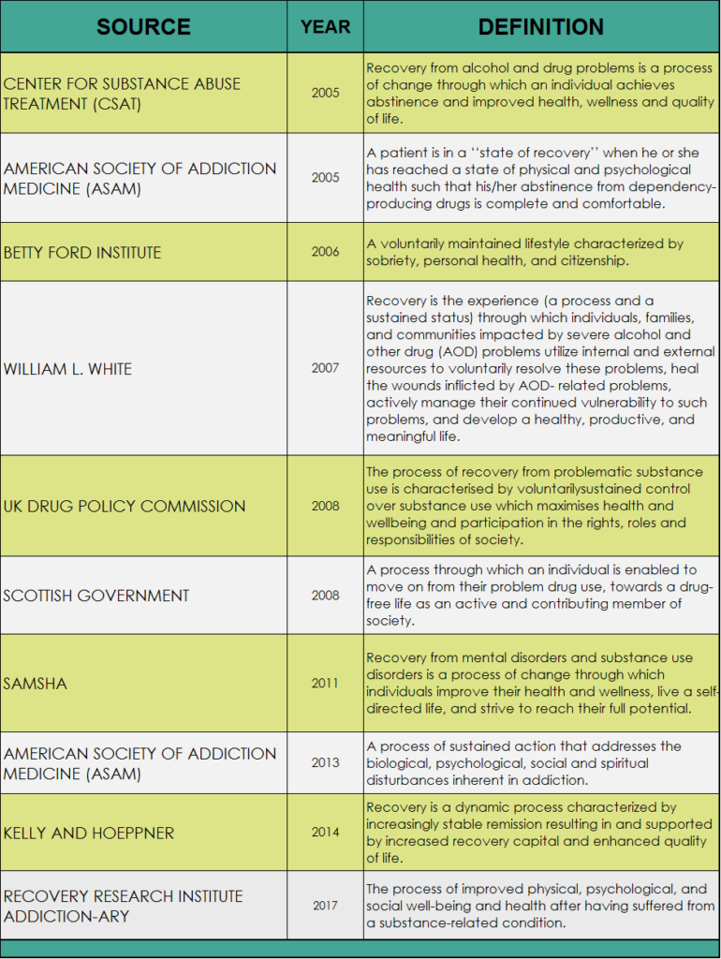
What Is Recovery?
SAMHSA
Source: https://www.recoveryanswers.org/resource/recovery-definitions/

Slide 6
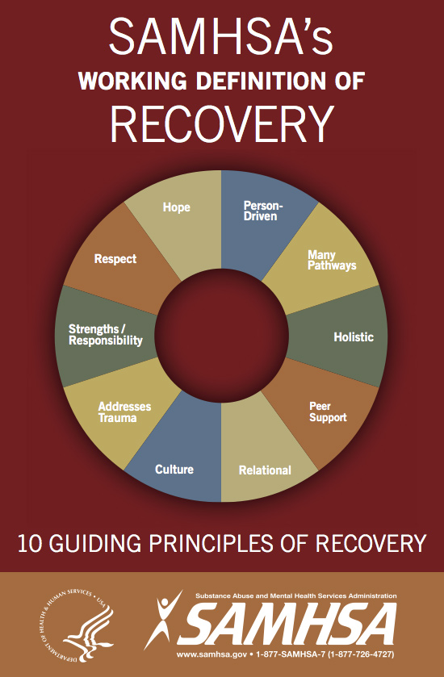
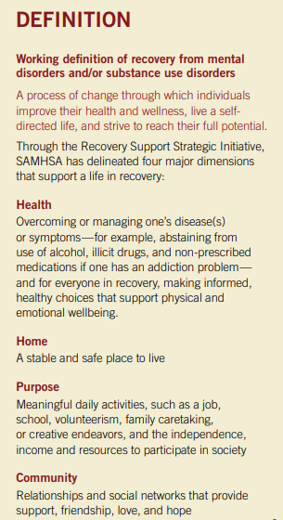
SAMHSA’s Working Definition of Recovery
Source: https://store.samhsa.gov/sites/default/files/d7/priv/pep12-recdef.pdf

Slide 7
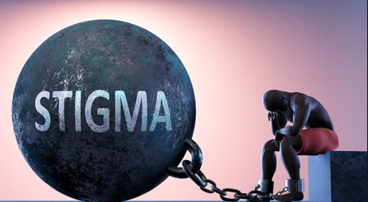
Stigma: Pervasive Insidious Sneaky Adaptive
Still using an opioid, not “clean”
Crutch
They’re still addicted, dependent
They’re not in recovery
They’re treading water; not going anywhere; not moving forward
It’s just social control
Liquid handcuffs
Source: https://aspe.hhs.gov/system/files/pdf/260791/BestSUD.pdf

Slide 8
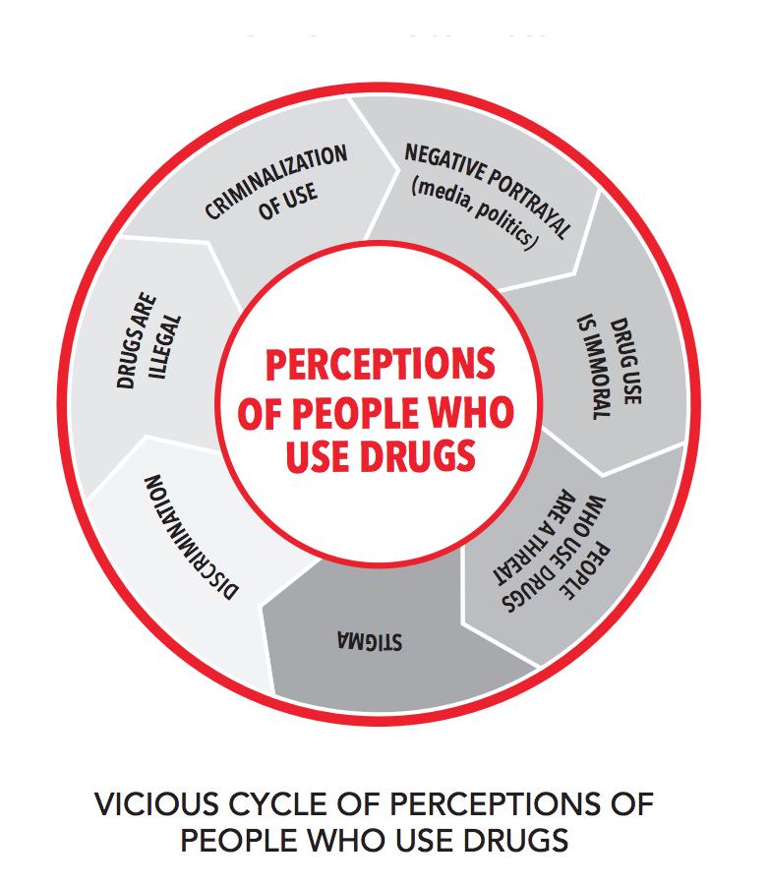
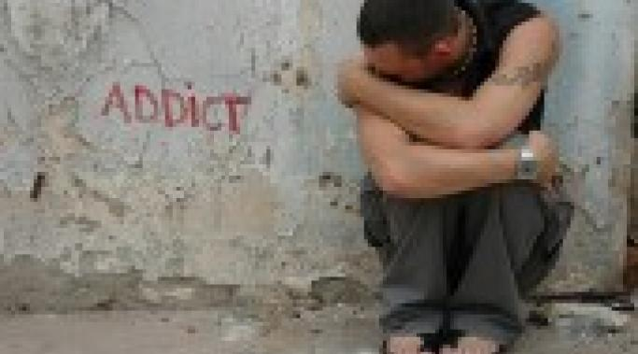
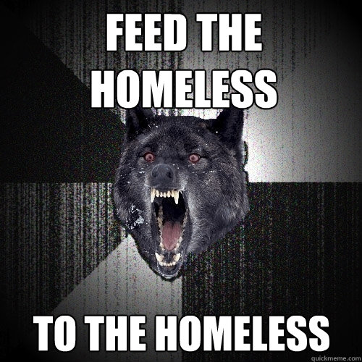
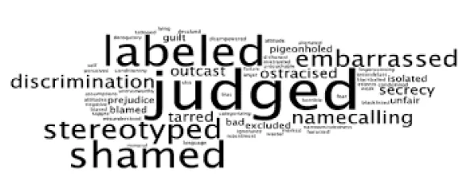
Meeting People Where They’re At

Slide 9
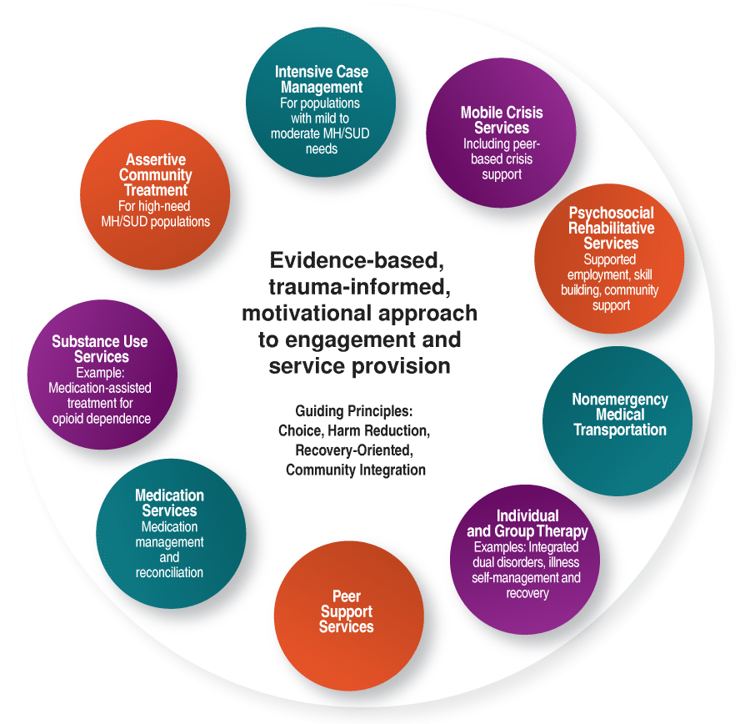
What Works?
Trauma informed, person-centered, strengths-based approaches
Recovery-Oriented Systems of Care (ROSC)
Peer support
Motivational interviewing
Person-first language
Harm reduction
Medication Assisted Treatment
Cultural competency
Source: https://ngahousingroadmap.cwsit.org/roadmap-develop-housing-services-strategy-03-incorporate-key-elements-of-behavioral-health-services.html

Slide 10
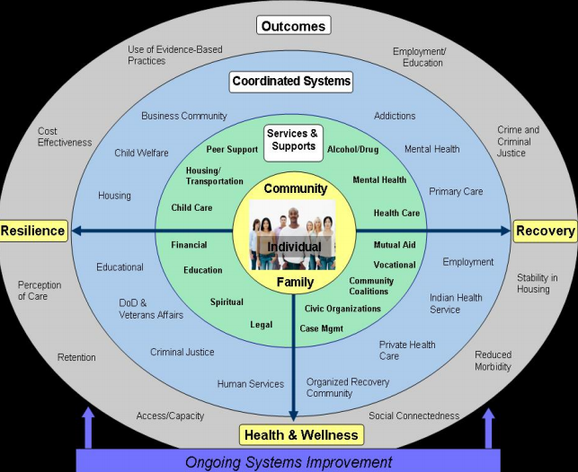
Recovery-Oriented Systems of Care
Recovery exists on a continuum of improved health and wellness.
Recovery is not a linear process. It is based on continual growth and improved functioning. It may involve return to use and other setbacks, which are a natural part of the continuum but not inevitable outcomes.
Wellness is the result of improved care and balance of mind, body and spirit. It is a product of the recovery process.
https://www.naadac.org/assets/2416/sheedyckwhitterm2009_guiding_principles_and_elements.pdf

Slide 11
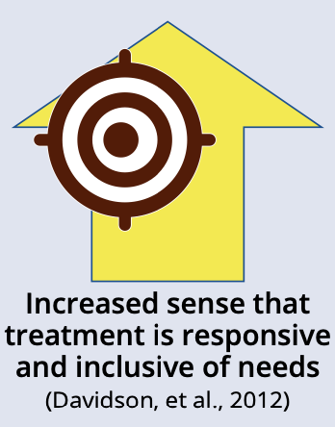
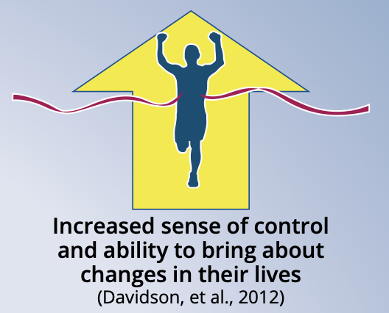
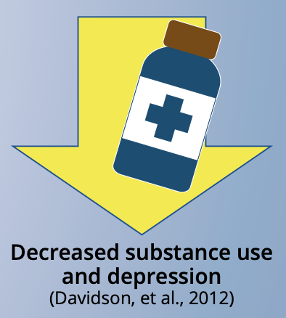
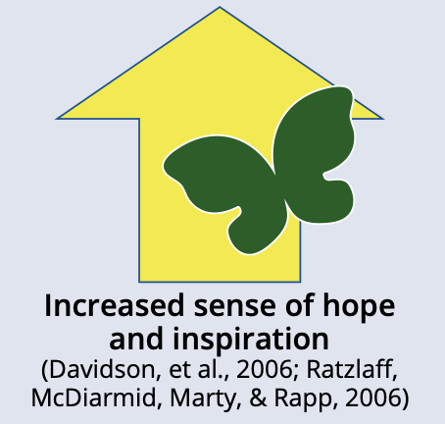
Peer Support
Peer support encompasses a range of activities and interactions between people who share similar experiences of being diagnosed with mental health conditions, substance use disorders, or both. This mutuality—often called “peerness”—between a peer support worker and person in or seeking recovery promotes connection and inspires hope.
Source: https://www.samhsa.gov/sites/default/files/programs_campaigns/brss_tacs/peer-support-2017.pdf
Notes:
Handout: Peer Support Toolkit And VALUE of Peers
Peer support is an evidence-based service and plays a central role in recovery-oriented systems of care for at least three primary reasons, and a host of other reasons as well.
First, mental illnesses and substance use disorders are stigmatized in our society, and many people with these conditions have been discriminated against as a result. Prejudice and discrimination can lead people with behavioral health disorders and their allies to feel hopeless, helpless, and despairing. Against a cultural backdrop of misinformation, pessimistic prognoses, and destructive stereotypes, peer staff provide invaluable, concrete proof of the reality of recovery. They instill hope that recovery is possible and demonstrate to people with behavioral health conditions, their loved ones, and behavioral health practitioners alike that decent, caring, and worthwhile people experience psychiatric and substance use conditions and—with sufficient and appropriate support—recover from them, as well.
Second, in part due to the stigma and misinformation described above, the majority of people with behavioral health conditions do not seek or receive timely or effective treatment. Only one in three people with a serious mental illness will access specialty mental health care, and only one in ten with an addictive disorder will access specialty substance use treatment. As living and breathing examples of recovery, peer support staff can attest to the utility and effectiveness of treatment, rehabilitation, and support. Peers are effective in engaging people into care who otherwise would not choose to access it, acting as a bridge between people in distress and what many people have experienced to be an impersonal, imposing, confusing and frankly dangerous system.
Third, by virtue of their own life experiences, peer support staff will have learned valuable lessons about how to access and use behavioral health care services and how to manage and overcome behavioral health conditions. This experience enables them to act as role models for people who are just entering into, or are early in, their own recovery. Peer support staff will have learned how to navigate the health and social service systems in their community, how to advocate for themselves within behavioral health programs, and how to persevere in the face of bias and discrimination. In addition, peers will have learned ways of managing, living with, and recovering from their own behavioral health conditions. This experiential knowledge complements the clinical and technical knowledge that practitioners acquire in their training and practice, and offers valuable assistance, especially to those struggling to contend with conditions that respond in very limited ways to existing treatments.
Peer support has FOUR key functions
Assistance in in daily management – Peer supporters use their own experiences with diet, physical activity and medicine adherence in helping people figure out how to manage their chronic diseases and other conditions in their daily lives.
Social and emotional support – Through empathetic listening and encouragement, peer supporters can help individuals to cope with social or emotional barriers and to stay motivated to reach their goals.
Linkages to clinical care and community resources – Peer supporters can help bridge the gap between the individuals and health professionals and encourage them to seek out clinical advice or treatments when it is appropriate. They can also help in identifying key resources in the community, such as where to buy healthy foods, or pleasant and convenient locations for exercise.
And finally, Peers provide Ongoing support, extended over time – Peer supporters successfully keep individuals engaged by providing proactive, flexible, and continual long-term follow-ups.
22 mins in

Slide 12
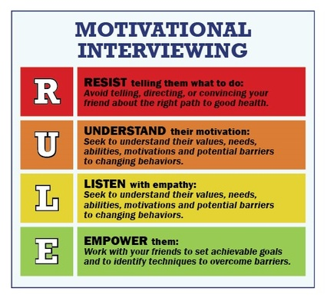
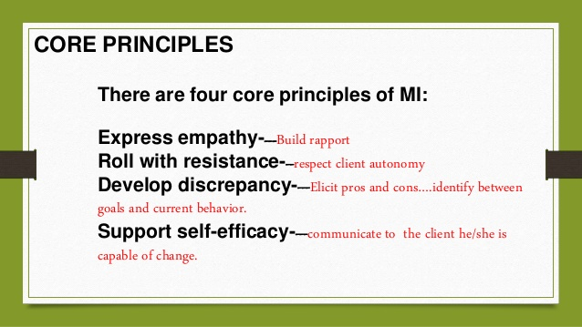
Motivational Interviewing
Source: https://motivationalinterviewing.org/understanding-motivational-interviewing

Slide 13
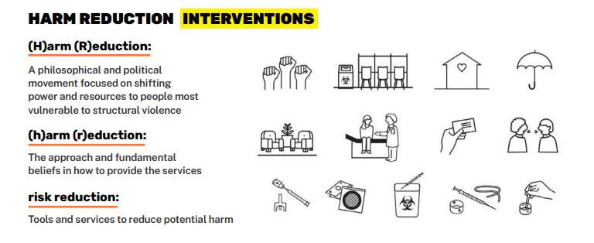
Principles of Harm Reduction
Harm reduction is a set of practical strategies and ideas aimed at reducing negative consequences associated with drug use
Harm reduction is also a movement for social justice built on a belief in, and respect for, the rights of people who use drugs
Source: https://harmreduction.org/

Slide 14
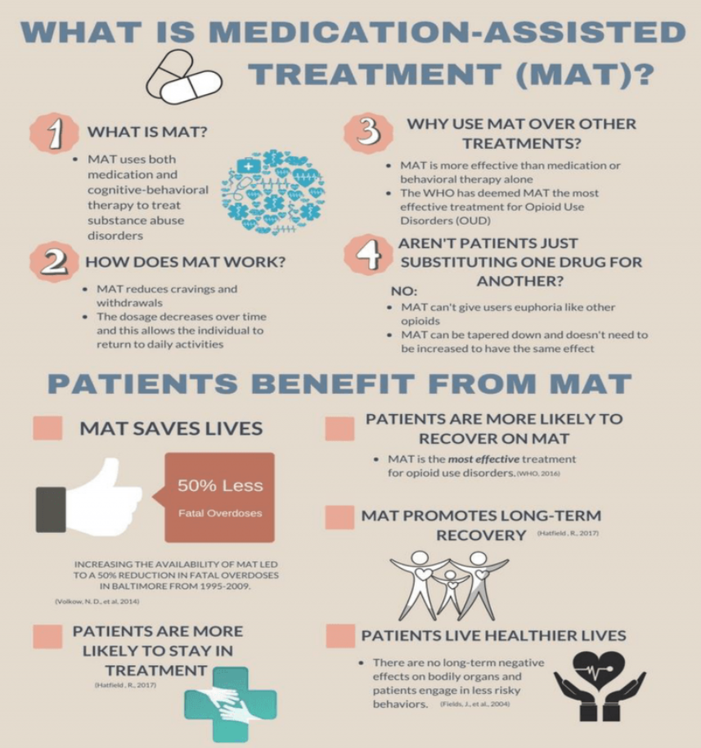
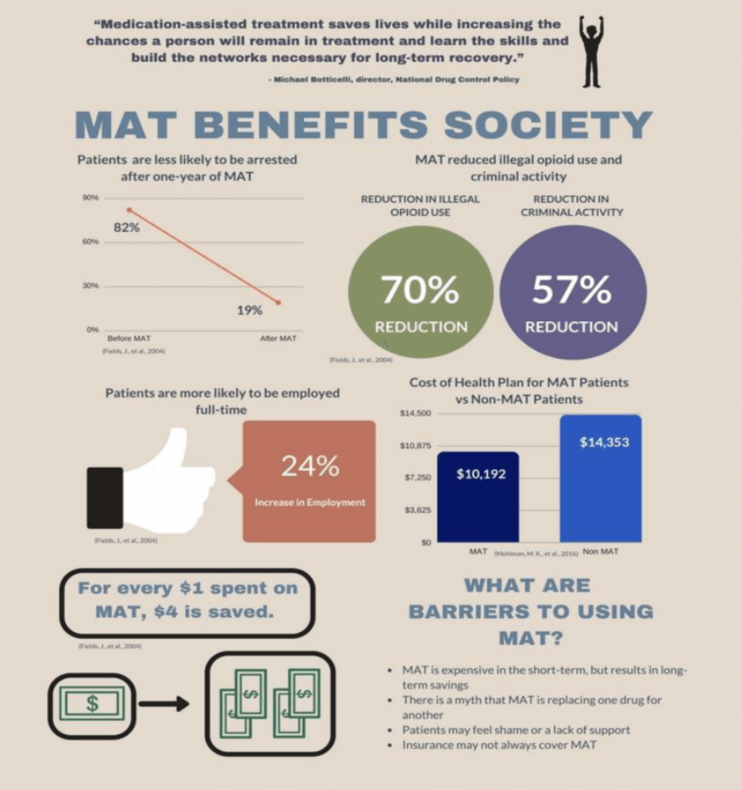
Medication Assisted Treatment (MAT)
Medication Assisted Recovery (MAR)
Medications for Addiction Treatment (MAT)
Medications for Opioid Use Disorder (MOUD)
Source: https://u.osu.edu/epic/epic-enhancing-permanency-in-children-and-families/about/services/family-treatment-drug-courts/medication-assisted-treatment-mat/ & https://mha.ohio.gov/Portals/0/assets/ResearchersAndMedia/Combating%20Opiate%20Abuse/Pocket-Guide-for-MAT-SMA16-4892PG.pdf?ver=2018-11-29-104924-477

Slide 15

Words Matter

Slide 16
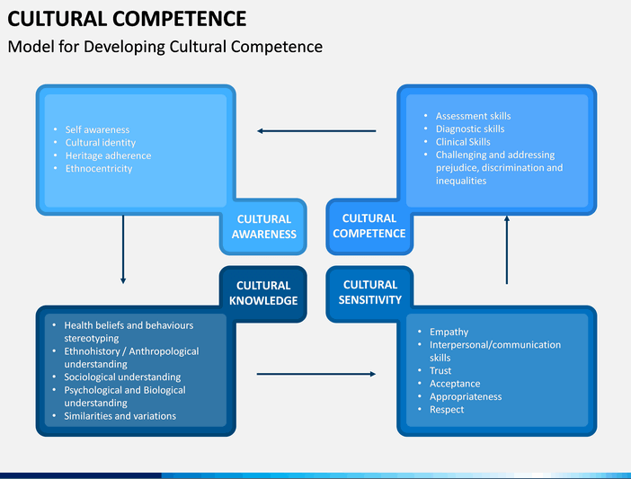
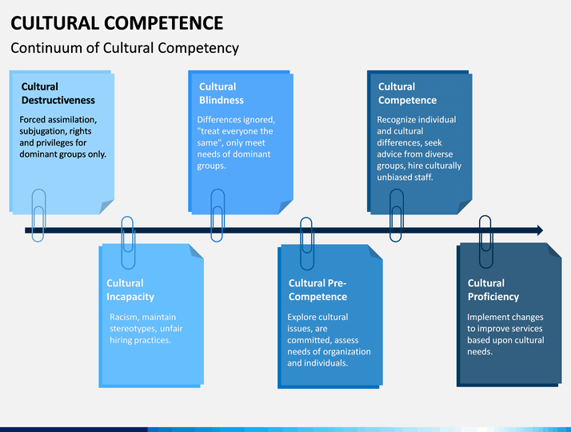
Cultural Competency
Source: https://npin.cdc.gov/pages/cultural-competence

Slide 17


The Rural Challenge:
STIGMA
Limited funding for recovery residences
Transportation challenges
Limited access to a continuum of care/recovery-oriented systems of care
Lack of detoxification facilities
Lack of wraparound services
Limited access to private and public health insurance
Economic and technological limitations
Limited access to transitional and long-term housing
Lack of anonymity
Too much misinformation & disinformation
Limited access to mutual-aid meetings
Limited access to employment
Lack of mental, dental, and health services
STIGMA
Source: https://www.usda.gov/sites/default/files/documents/rural-community-action-guide.pdf

Slide 18

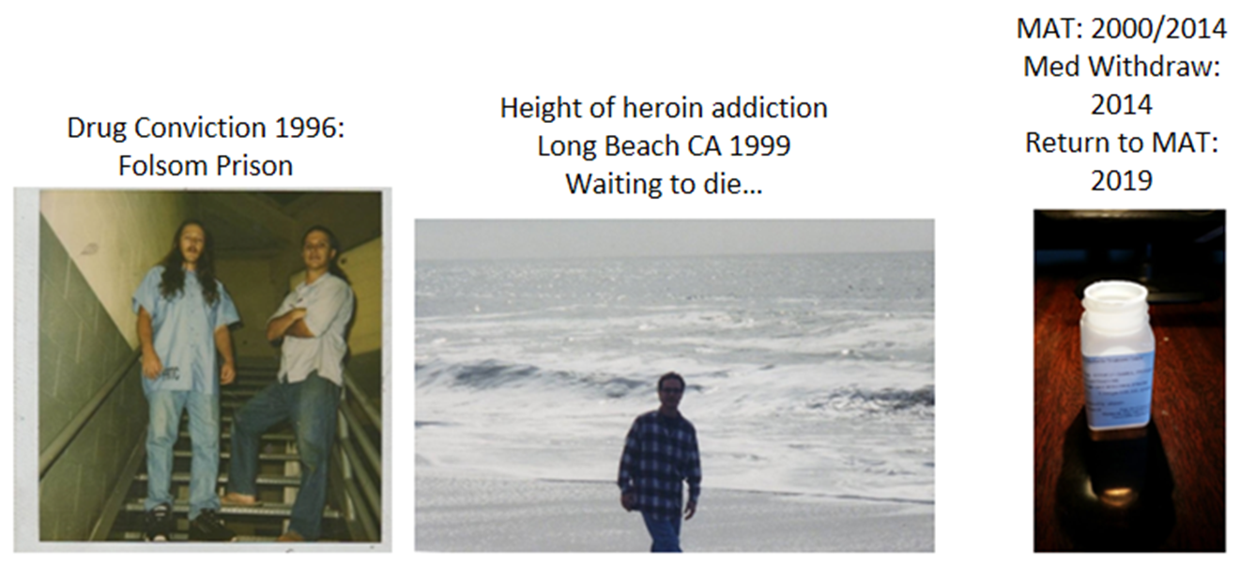
As our journey together ends…

